Slide 1
UNIVERSITY OF COMPUTER STUDIES (THATON) Estimating Cost of Building Third Seminar
Supervised by
Dr. Yu Wai Hlaing
Presented by
Group-6

Slide 2
Group Member
5CS -7 Ma Yamin
5CS -20 Ma Thinzar Aung
5CS -34 Ma Pyae Phyo Oo
5CS -56 Ma Thae Su Khin
5CS -68 Mg Shein Ko Ko Aung (Leader)
5CS -88 Mg Wai Linn Tun

Slide 3
Objectives
To make easier cost estimating on building construction for single -storey
To safe time ,money and human efforts

Slide 4
Outline
Abstract
Introduction
Input and Output
System Design
Function of estimator for update
Function of estimator for calculate
Use case Diagram for system
Database Design
User Interface Design
Limitation
Future work
Conclusion

Slide 5
Abstract
The system estimates the cost of building for single storey.
Everything within the estimator’s brief is included the cost planning process.
Estimators can manage the standard value of raw materials in the current year.

Slide 6
Introduction
Accurately forecasting the cost of future construction is vital for the cost estimators
Cost estimators will determine construction bid or whether the company will bid on the construction contract
In our project , we estimate the construction cost on per square feet by counting on all material used in construction

Slide 7
Input and Output
Input
Length, Width and height for all building part
User name and Password
Room number and Door number
Output
Estimate number and price of raw materials

Slide 8
System design
Start
Login
No
Check
(username & Password)
Yes
View building flow
Calculate cost of Building
Update information for Building
Update information for Building
View About Us
Database
End

Slide 9
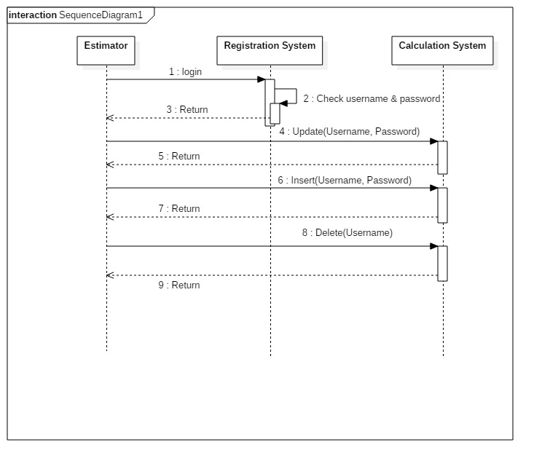
Function of Estimator for Update

Slide 10
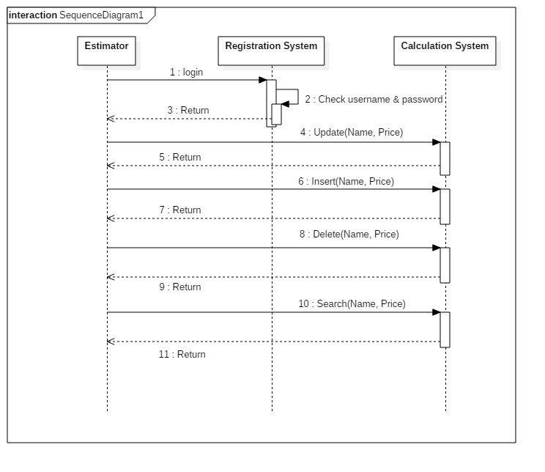

Slide 11
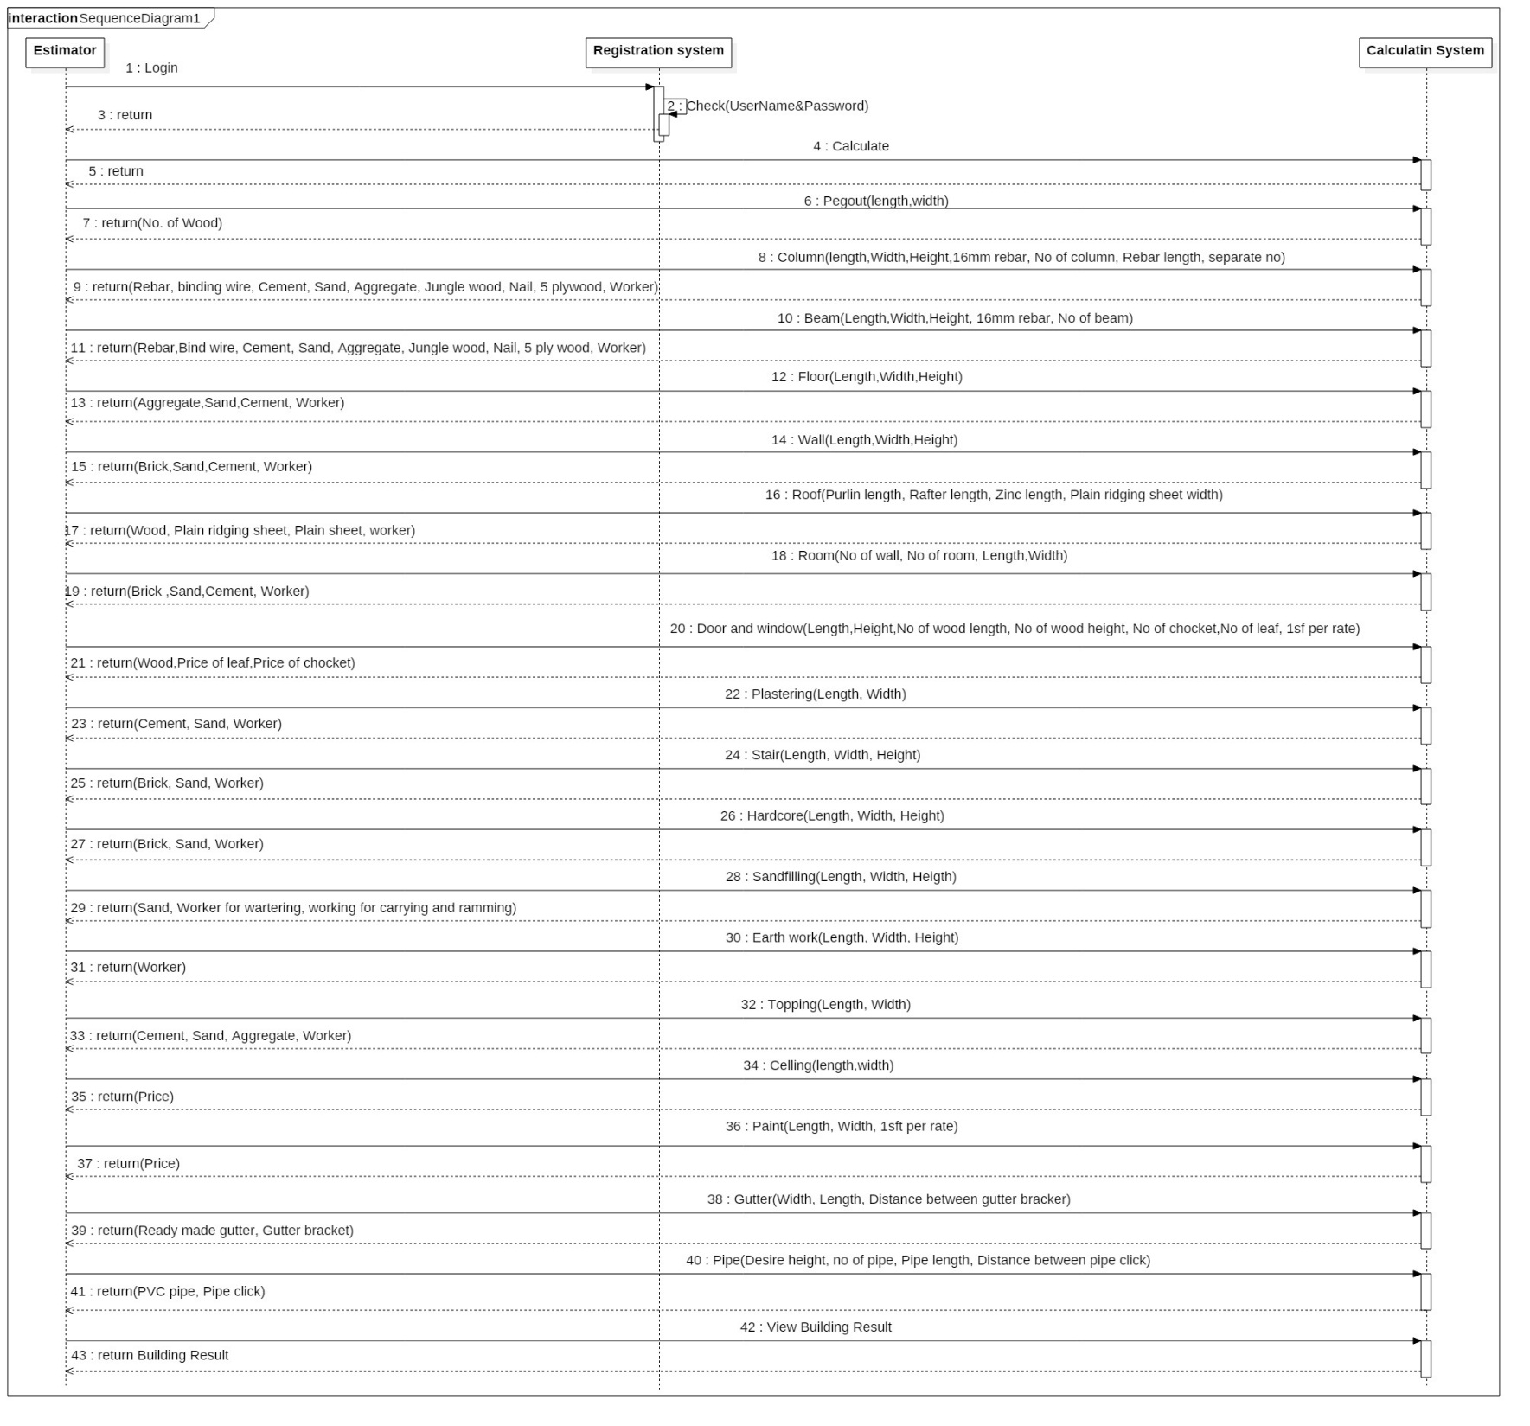
Function of Estimator for Calculate

Slide 12
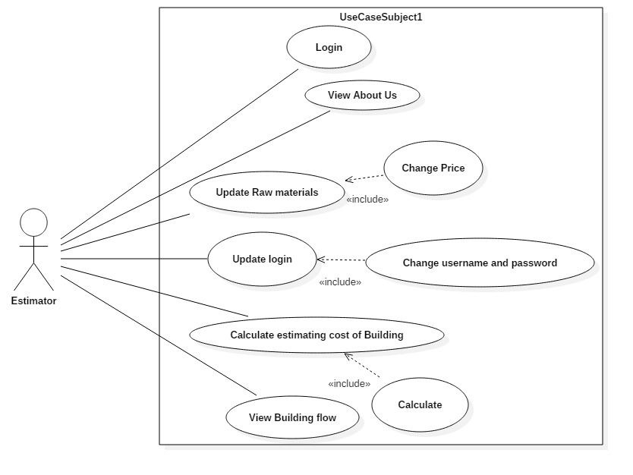
Use Case Diagram For System

Slide 13
Login
Field | Type | Collation | Attribute | Null | Default | Extra
Username | Varchar(30) |  |  | NO
Password | Varchar(30) |  |  | NO

Slide 14
Raw materials
Field | Type | Attribute | Collation | Null | Default | Extra
Name | Varchar(30) |  |  | NO
Price | Int |  |  | NO
Total NO | Int |  |  | NO
Total Price | Int |  |  | NO

Slide 15

User Interface Design
Fig. Login form

Slide 16
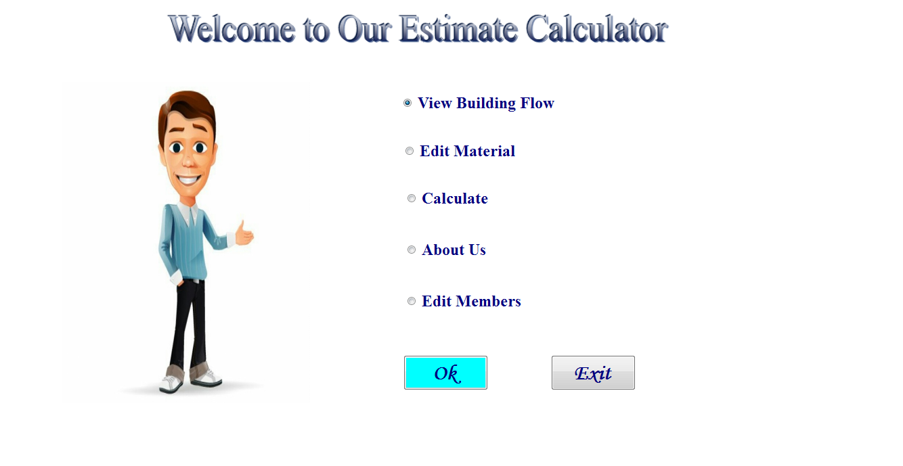
.
Fig. Welcome Form

Slide 17
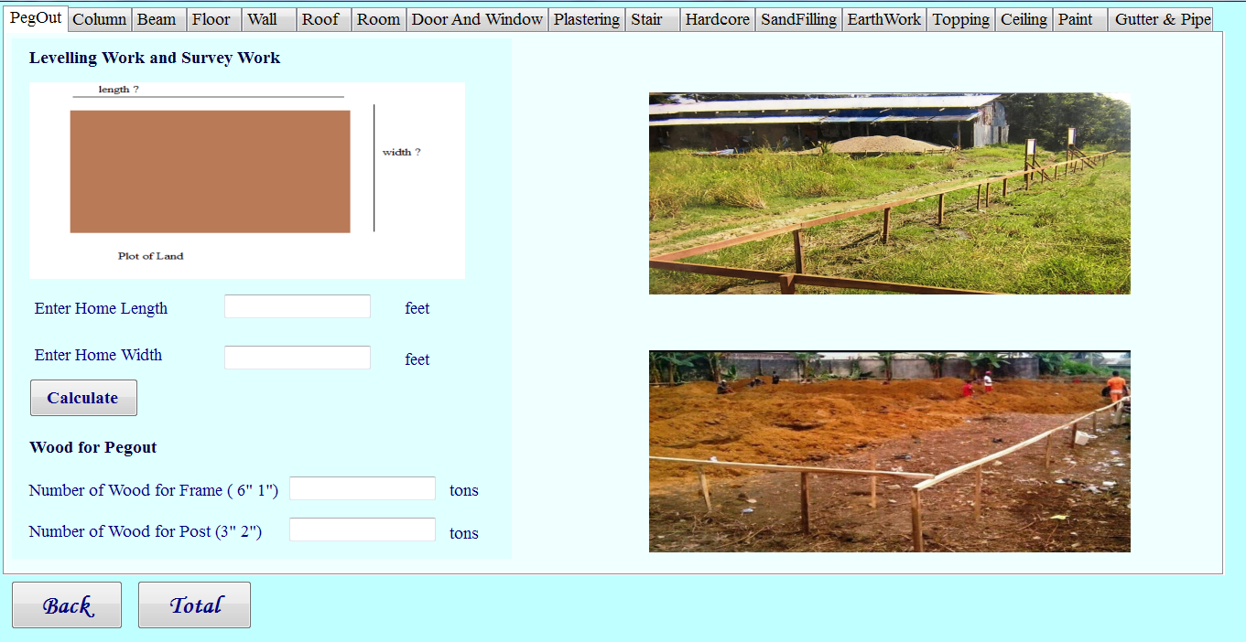

Slide 18
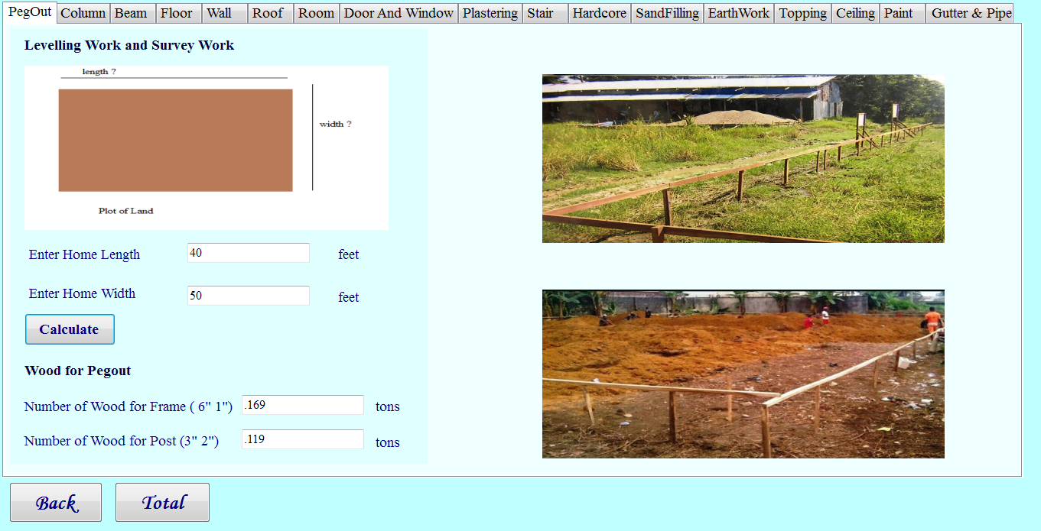
Fig. Pegout Form

Slide 19
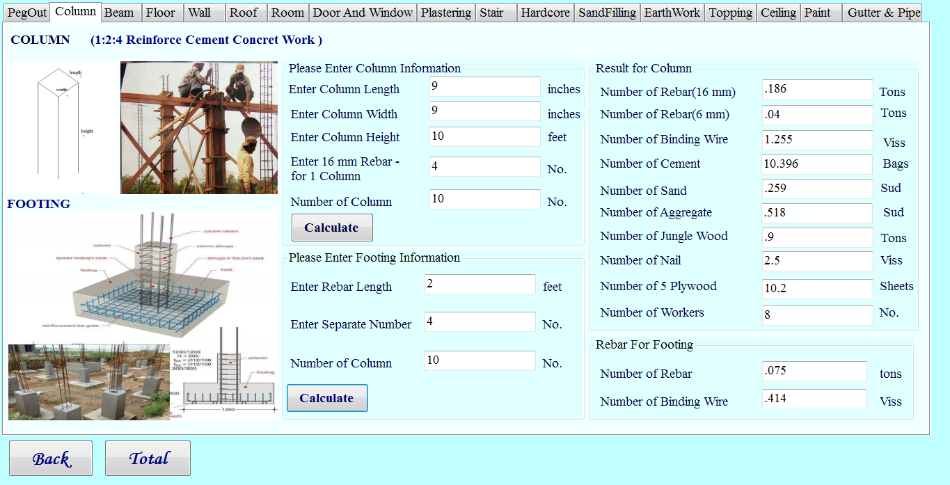
Fig. Column Form

Slide 20
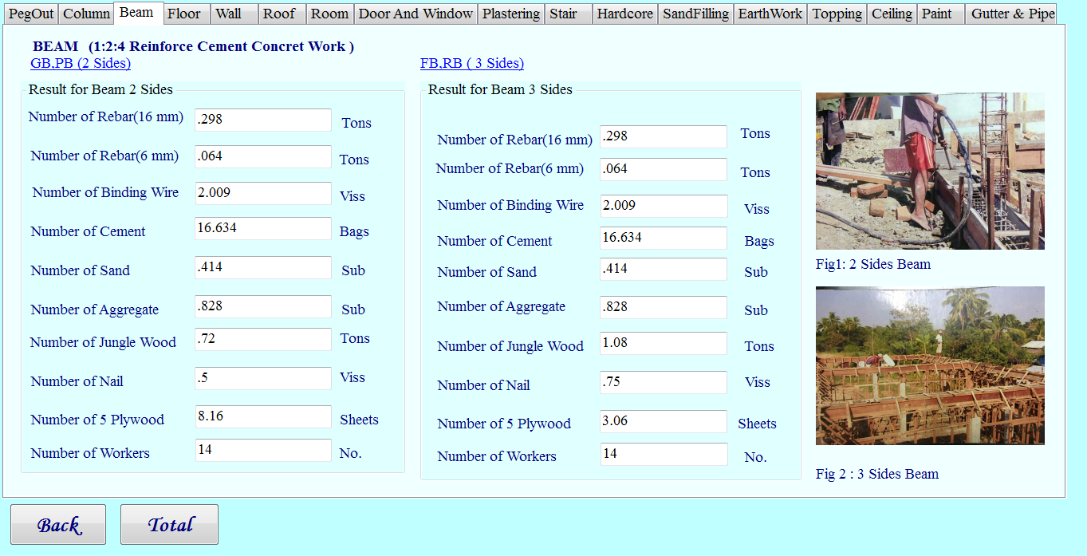
Fig. Beam Form for 2 Sides and 3Sides

Slide 21
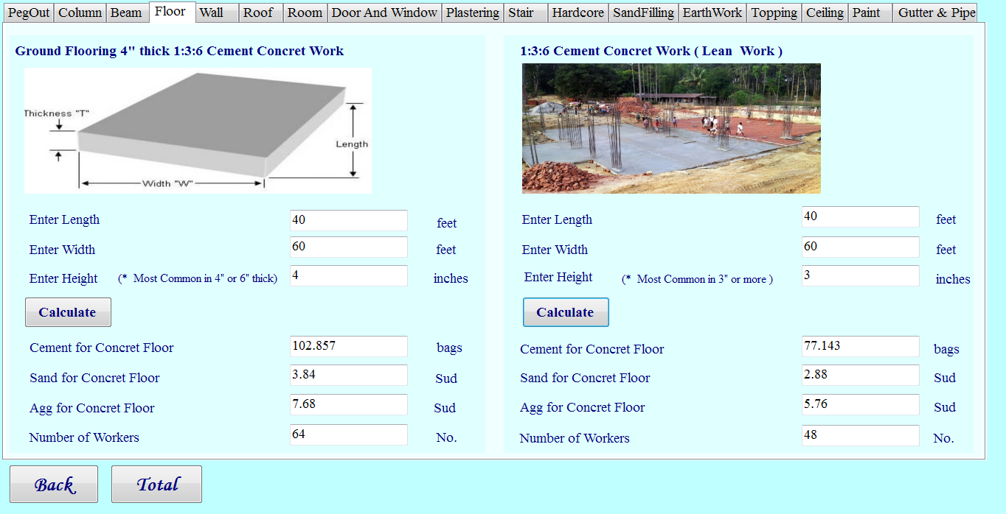
Fig. Floor Form

Slide 22
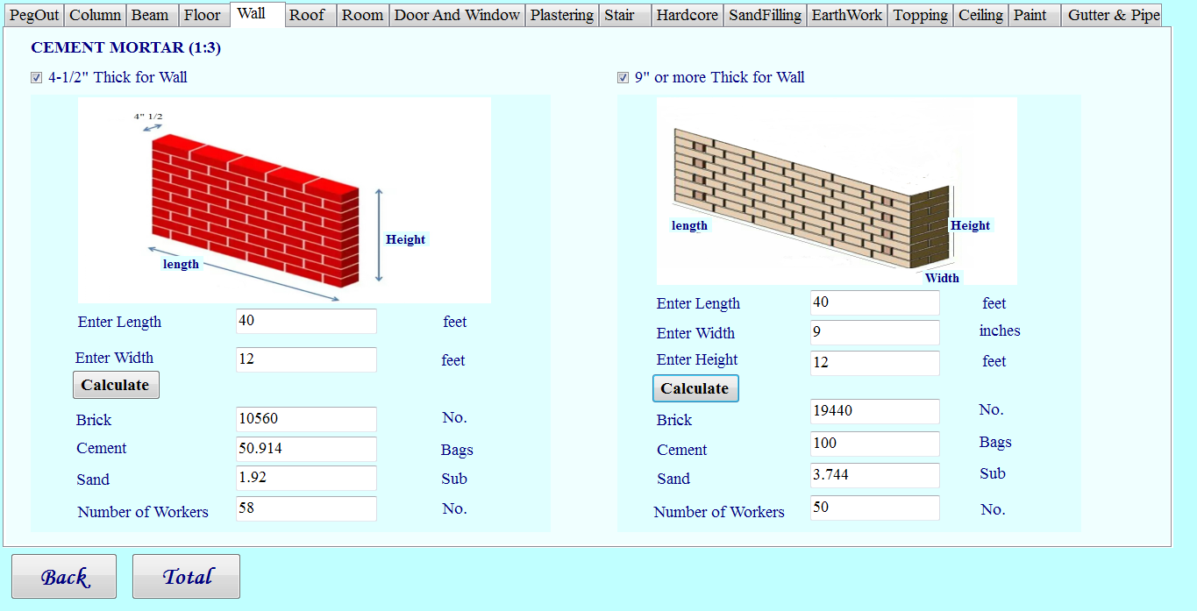
Fig. Wall Form

Slide 23
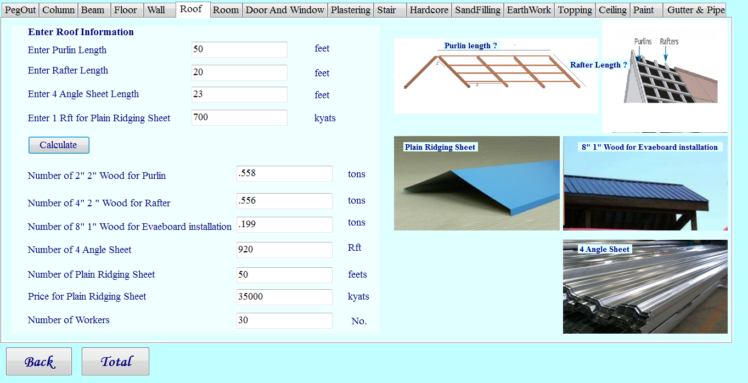
Fig. Roof Form

Slide 24
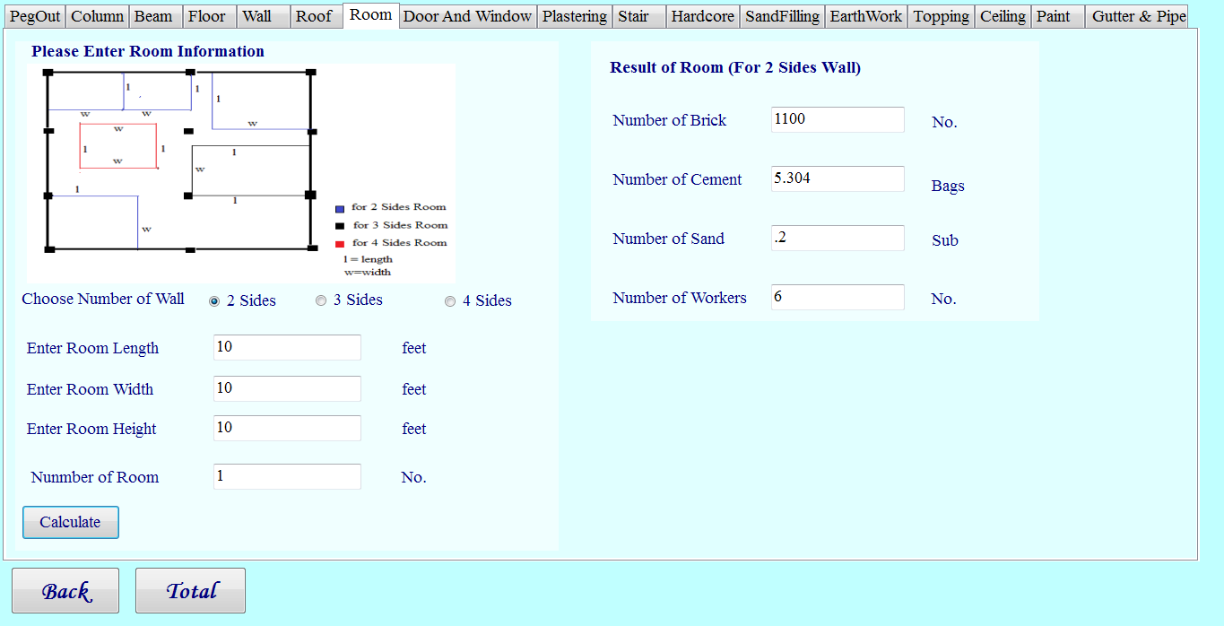
Fig. Room Form for 2 Sides

Slide 25
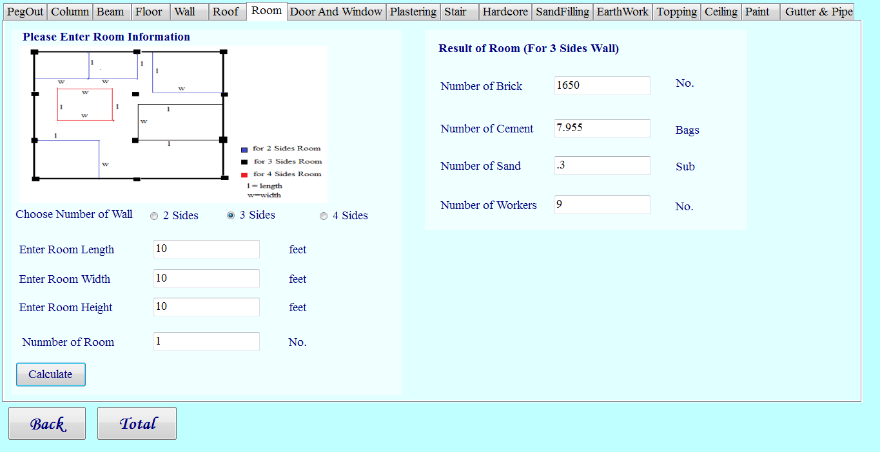
Fig. Room Form for 3 Sides

Slide 26
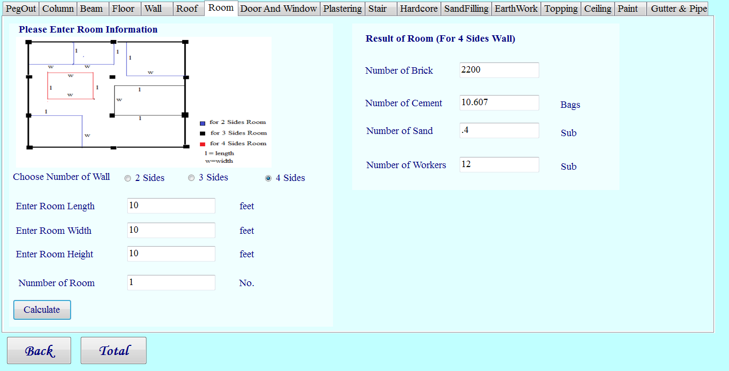
Fig. Room Form for 4 Sides

Slide 27
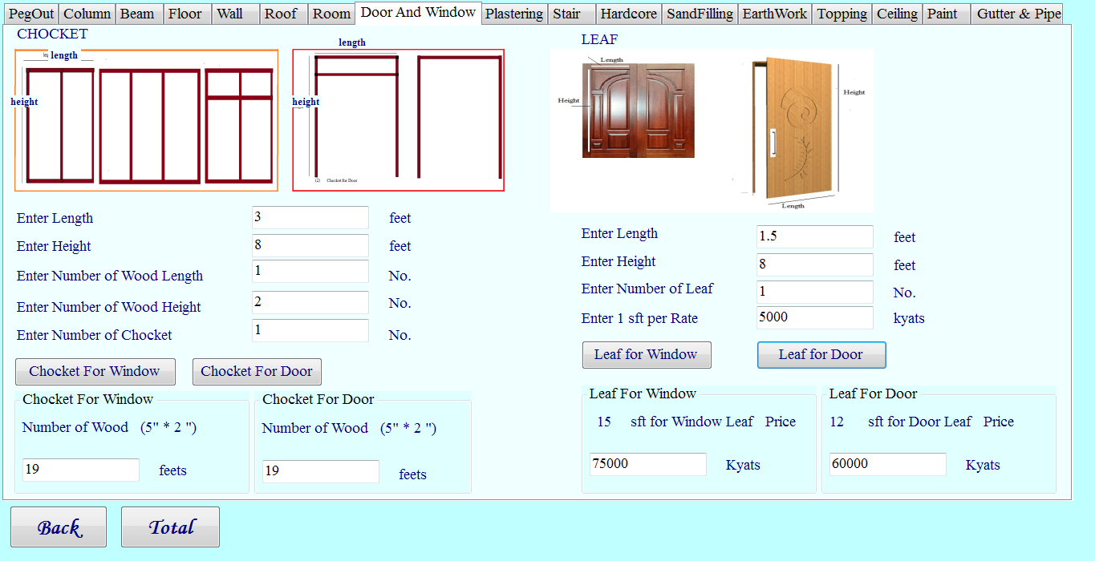
Fig. Door and Window Form

Slide 28
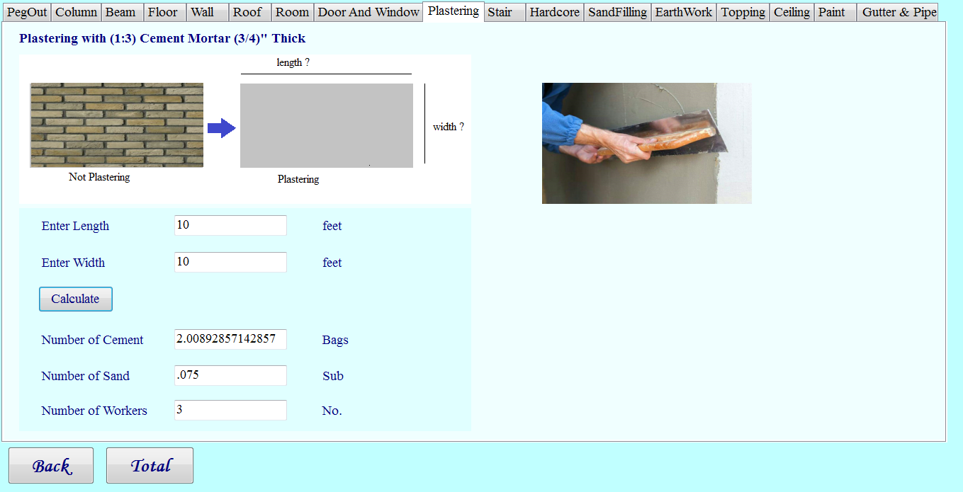
Fig. Plastering Form

Slide 29
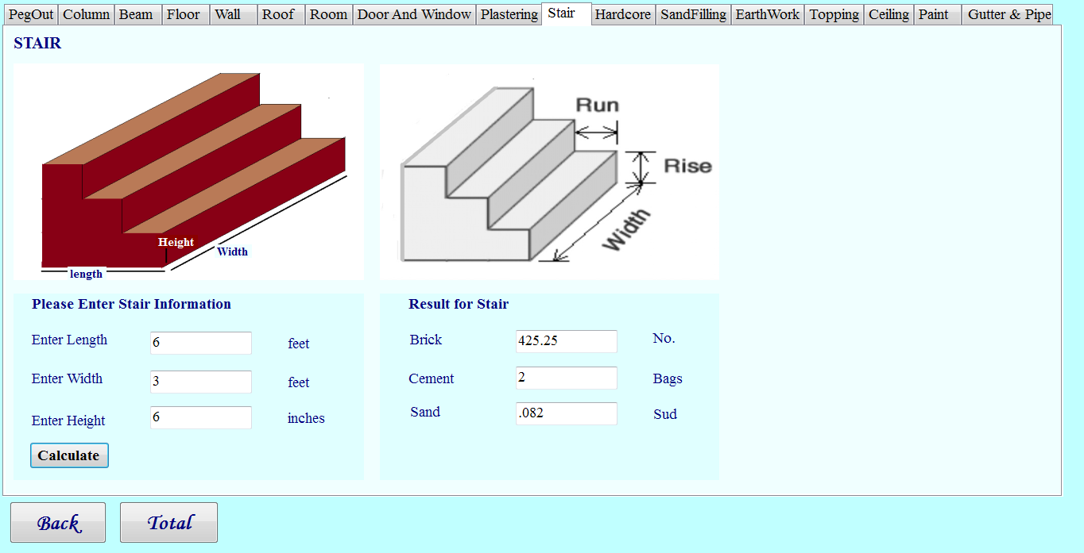
Fig. Stair Form

Slide 30
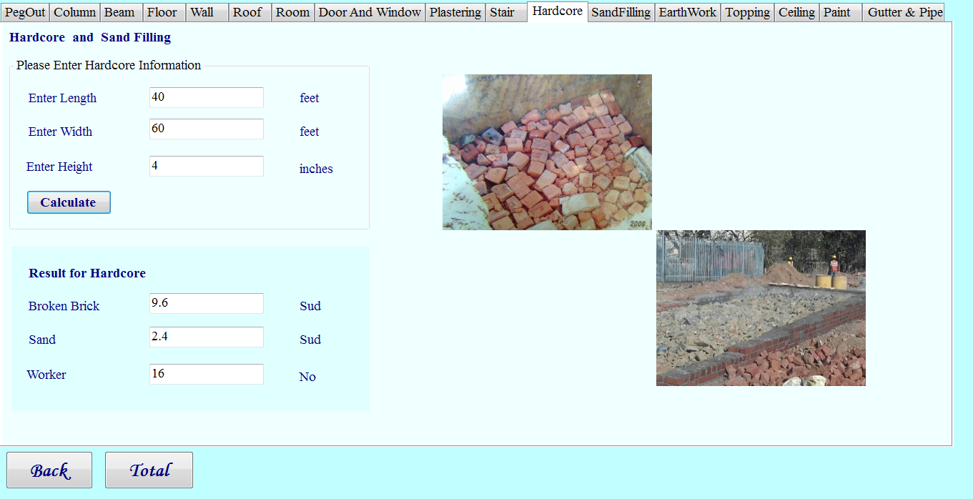
Fig. Hardcore Form

Slide 31
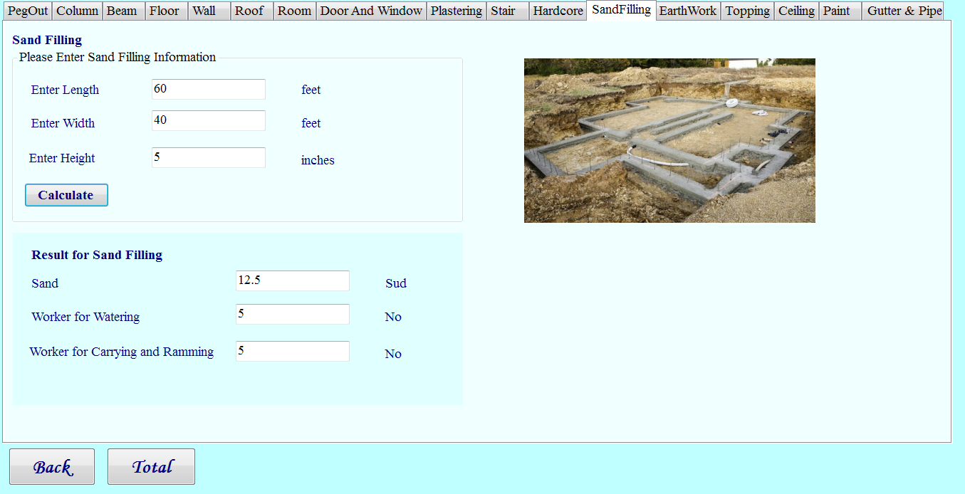
Fig. SandFilling Form

Slide 32
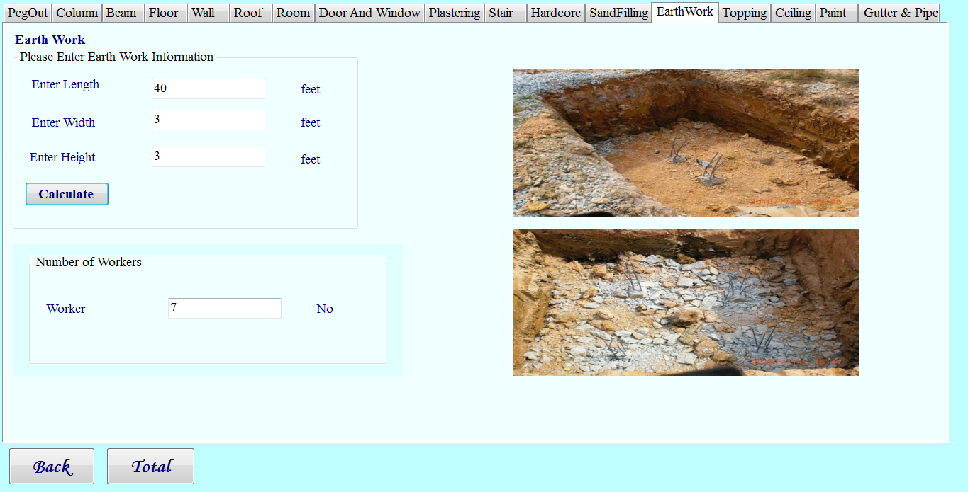
Fig. Earthwork Form

Slide 33
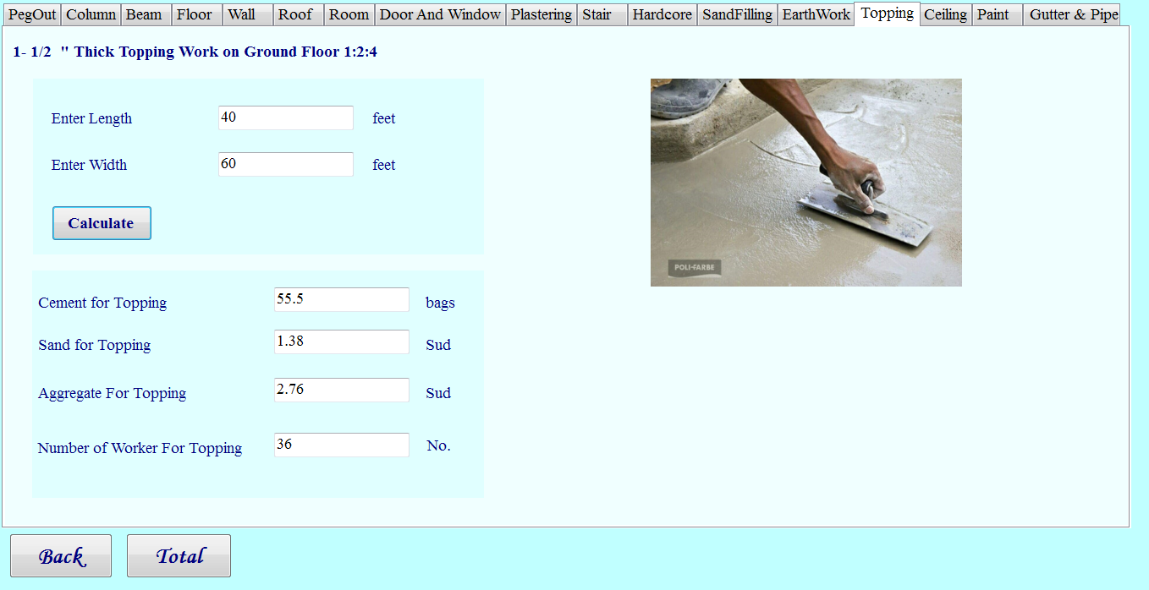
Fig. Topping Form

Slide 34
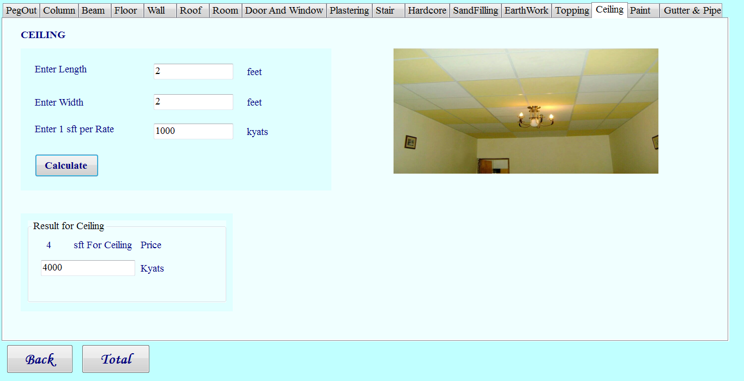
Fig. Ceiling Form

Slide 35
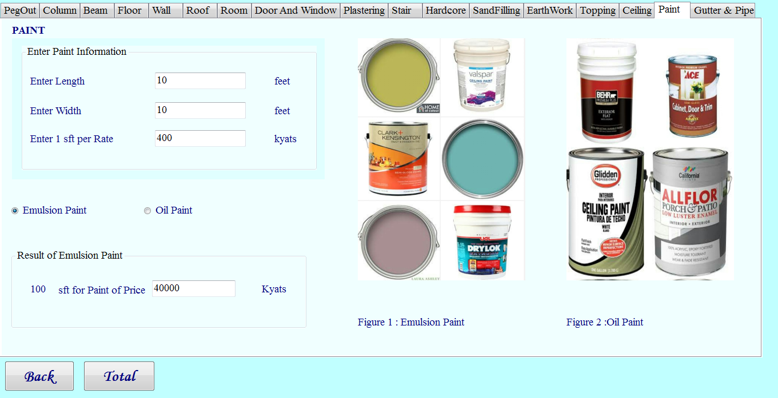
Fig. Paint Form for Emulsion Paint

Slide 36
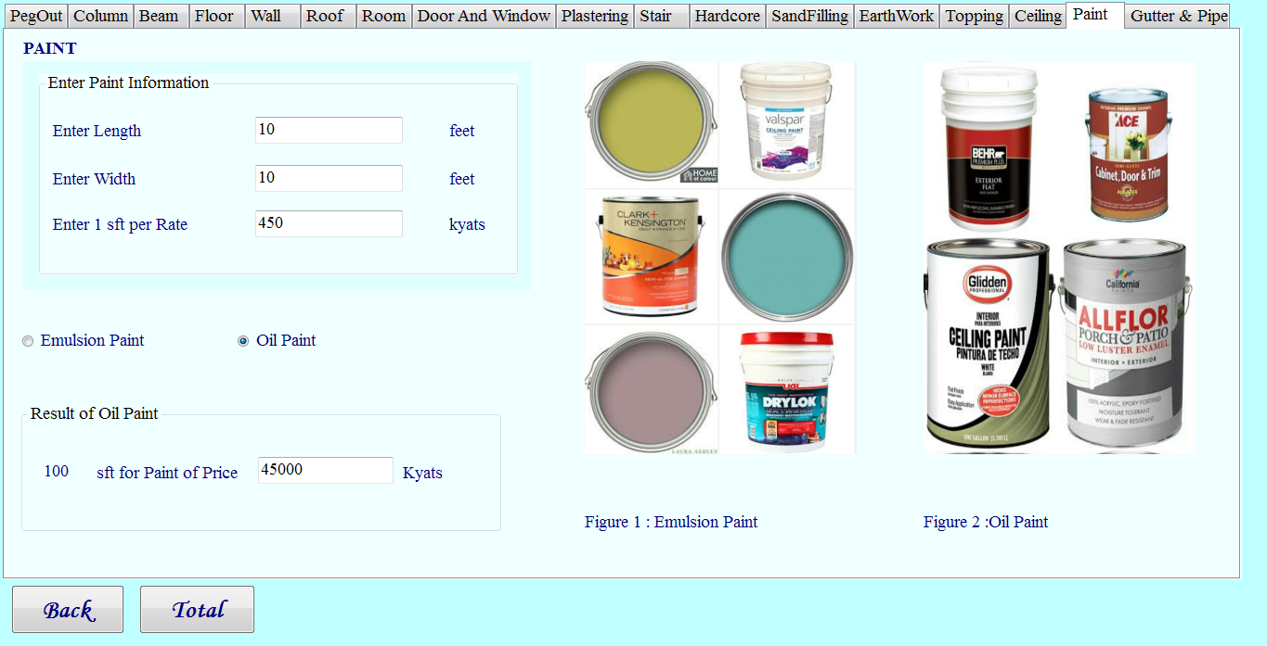
Fig. Paint Form for Oil Paint

Slide 37
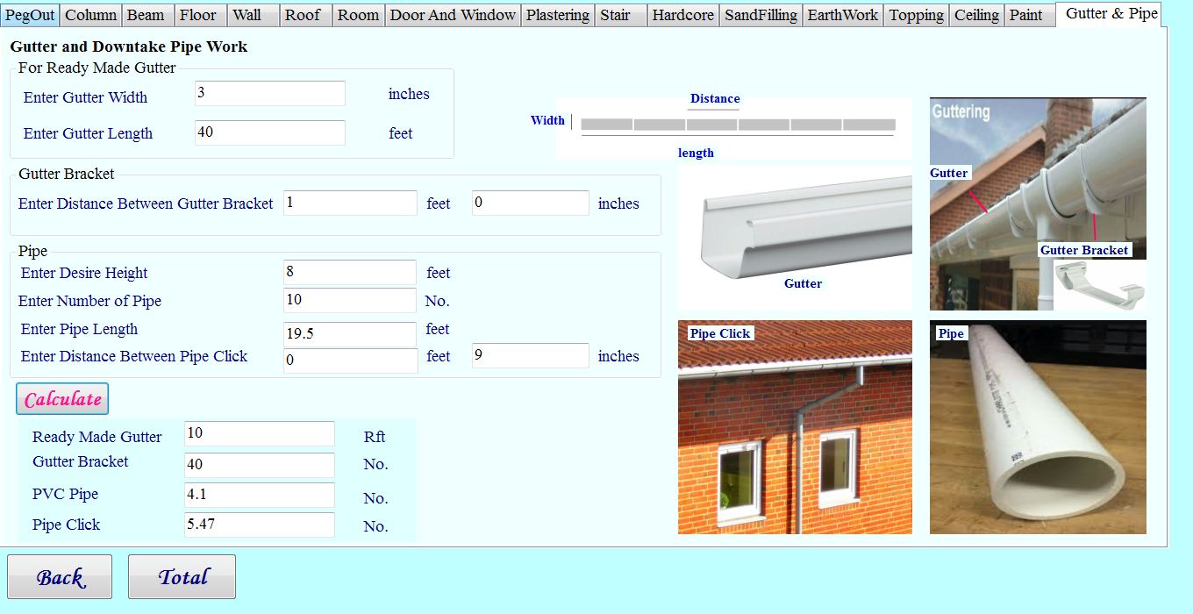
Fig. Gutter & Pipe Form

Slide 38
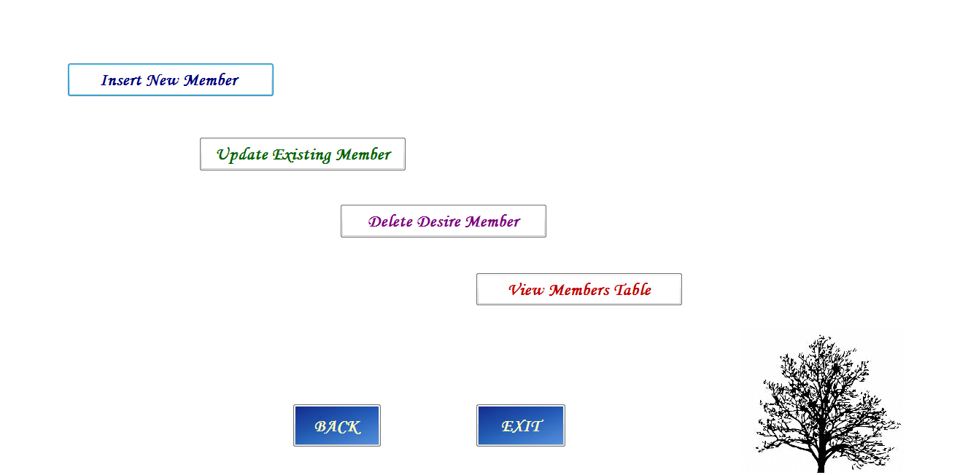
Fig. Edit Member Form

Slide 39
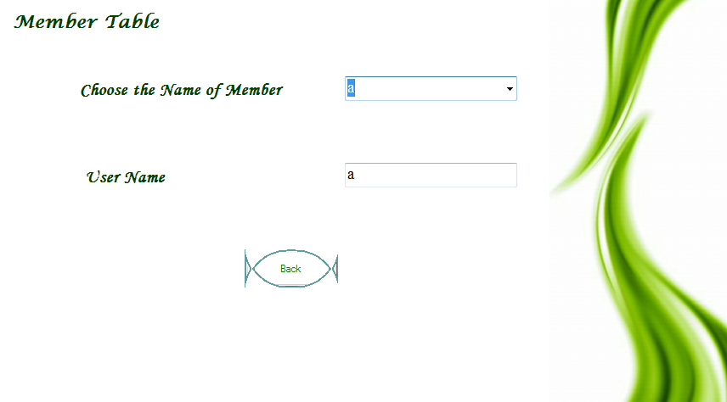
Fig. Member Table Form

Slide 40
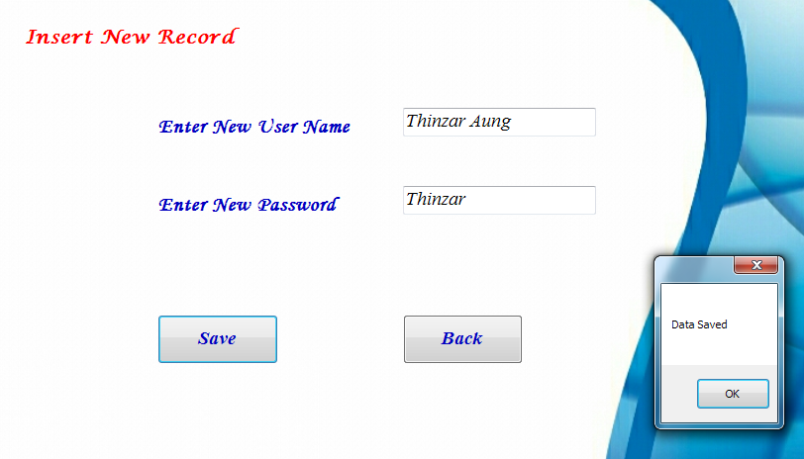
Fig. Insert Member Form

Slide 41
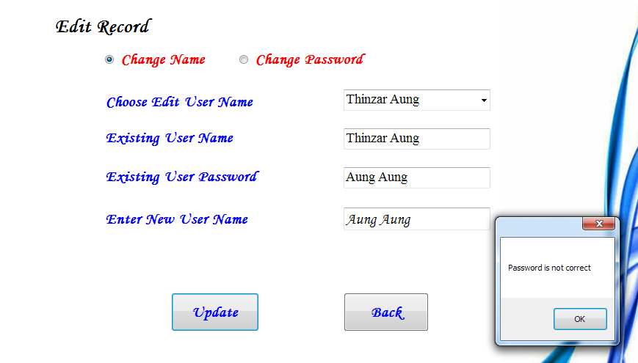
Fig. Change Name for Edit Member Form

Slide 42
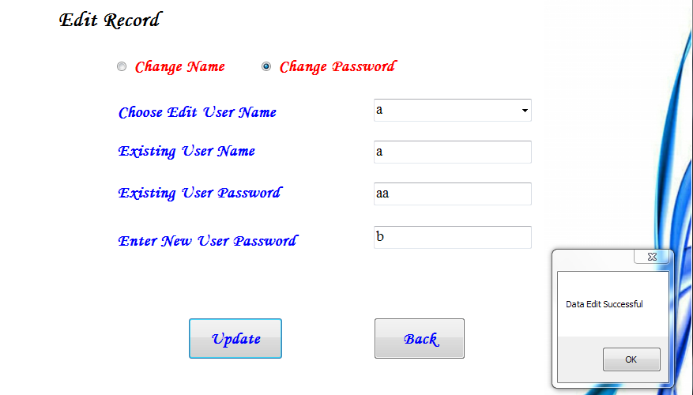
Fig. Change Password for Edit Member Form

Slide 43
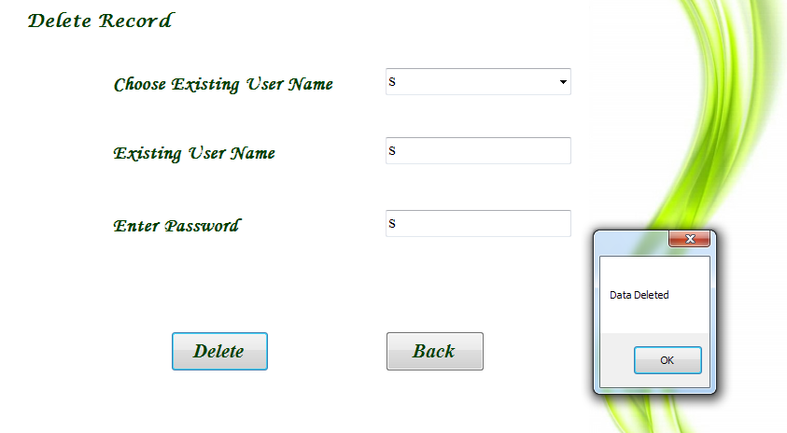
Fig. Delete Member Form

Slide 44
Limitations
Our system only intend to support Estimator for building
single _ storey.

Slide 45
Future Works
Our system can be extended for two _storey and more.
We can extend this system in order to support both English and Myanmar Language.
We can extend home decoration.

Slide 46
Conclusion
The system can help difficulties of obtaining construction information
Estimator can estimate number and cost of raw materials when they need anytime

Slide 47
Thank You

